Slide 1
Probation II
Organization of Probation
Probation Supervision
Probation Effectiveness & “Felony Probation”

Slide 2
Organization of Probation
Three Central Categories
Centralized vs. Decentralized
Judiciary vs. Executive Branch
Combined With Parole?
No clear consensus for model nationally
Minnesota?
Depends on what county you are in

Slide 3
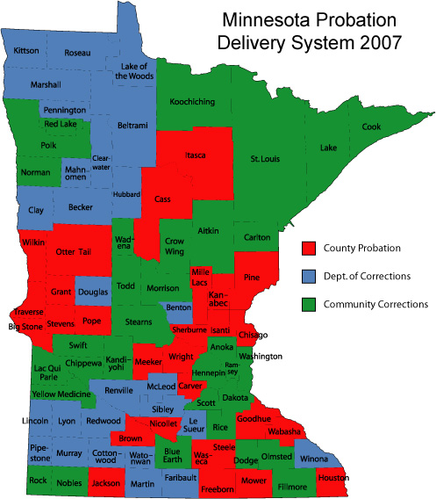

Slide 4
Dual Functions of Probation
Investigation (PSI)
Review
Supervision
Police vs. Social Work Aspects
Role Conflict?
Authoritarian
Social Work
Hybrid
Firm but fair

Slide 5
Paparozzi and Gendreau (2005)
TYPE OF P.O. | Technical Violations | Arrests for New Offense
Social Work | 5% | 32%
Authoritarian | 43% | 16%
Hybrid | 13% | 6%

Slide 6
Defining “Success” and Failure in Probation
Success typically low “Recidivism”
But, recent authors argue for other definitions
Danger here?
What counts as “Recidivism?”
New Arrest
New Conviction
Re-Incarceration (May include technical violations)

Slide 7
Other Research Issues
Follow-up Period
Typically 3 years
Sample Composition
What type of probationers? (representative?)
Probation department
Funding (“Program Integrity”)
Social Context of Study
Anything going on in state/county?

Slide 8
The RAND Study (Funded by NIJ)
Sample
1,672 Male “Felony” Probationers
Drug sales/possession, receiving stolen property, auto theft, robbery, assault
From Alameda and Los Angeles Counties
Tracked an average of 31 months

Slide 9
Results—Disseminated in NIJ “Research in Brief”
Rearrested
65%
Convicted
51%
Incarcerated
34%
Startling: 18% convicted of homicide, rape, aggravated assault, robbery or weapons offenses

Slide 10
Conclusions of Authors
Probation, designed for less serious offenders, is “inappropriate for most felons”
Probation needs to be “redefined”
Quasi-policing strategies
Development of “Intermediate Sanctions”
Especially the “Promising” ISPs
NIJ: Prison is expensive, but you see what happens when we use probation…

Slide 11
Follow-Up Studies Attempts to Replicate
Vito (1986)
Representative sample in KY
22% arrest, 18% convicted, 14% incarcerated
McGaha (1986)
All MO felony probationers in 1980
22% arrest, 12% conviction
Whitehead (1991)
All NJ convicted of drug, robbery, burglary in 1976-77
36% arrest, 31% conviction, 15% incarceration

Slide 12
Follow-ups Cont
Langan and Cunniff (1992)
32 Counties across 17 states
43% arrested, 36% incarcerated
Fabelo (1996)
Seven most populous counties in TX
31% incarcerated

Slide 13
So Ya See Timmy….
“Representative Samples”
Much lower recidivism rates
Closer to the Rand Study?
Most populous counties in TX
“Urban” Counties in U.S.

Slide 14
Revisiting the Original Study
Petersilia et al. (1986)
Matched (priors, seriousness, other risk factors) a group of felons to the original RAND probation sample
Difference? The Matched Sample went to prison
Findings?
Matched sample that went to prison = 78% arrest
NIJ refuses to publish brief on this study
Similar to “Martinson Recant”

Slide 15
CA and TX in the mid 1980s?
Funding for Probation in CA counties cut 10%, personnel down 30%, while population doubled
Severe prison and jail crowding
Follow up studies contained “less serious” offenders
TX had similar conditions
Original “full” RAND report
“Our sample is probably not representative of California, much less probation in general”

Slide 16
Lessons from “Felony Probation” Studies
“Felony status” not an important predictor of recidivism
Offender characteristics (prior record, age, employment, drug use) more important
There is wide variation in the success of probation
Like rehabilitation, much depends on “program integrity”

Slide 17
In other words…
It is probably unwise to take the most serious offenders from counties with severe jail/prison crowding, where probation services have been cut, and use them to represent “PROBATION”

